Slide 1
CRUD Your Cloud
with C# and Pulumi

Slide 2

Me (Al Rodriguez)
ProgrammerAL
Twitter, LinkedIn, personal website, etc
Misc
Programmer
Podcaster
Orlando IoT
NOT affiliated with Pulumi

Slide 3
Materials
All Presentations: github.com/ProgrammerAl/Presentations-2022

Slide 4
Storytime
Started looking into Terraform
Needed to learn Got overwhelmed
Found Pulumi. Got to use my choice of language with Visual Studio

Slide 5
What is Pulumi?
Tooling for managing cloud infra
Create/Read/Update/Delete services
IaC - Infrastructure As Code
DSC – Desired State Configuration
Works with major and less-major cloud providers
Use your choice of programming language*
Open Sourced
Can be free if you selfhost Pulumi
Easier to pay for their Services. Free for light use, like personal projects

Slide 6
What isn't Pulumi
Cross-Platform Abstraction
Cross-Cloud, BUT you target specific clouds...usually

Slide 7
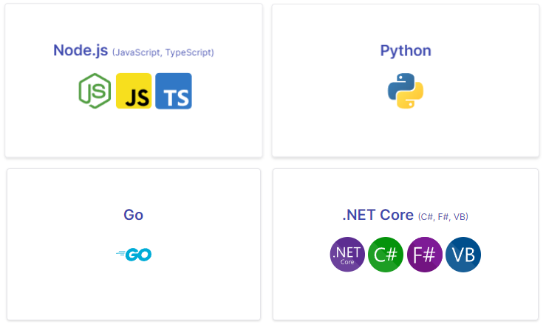
What does it work with?
All big cloud providers
And More!
https://www.pulumi.com/registry/

Slide 8
Quick Demo!
CLI
Code
Web Portal

Slide 9
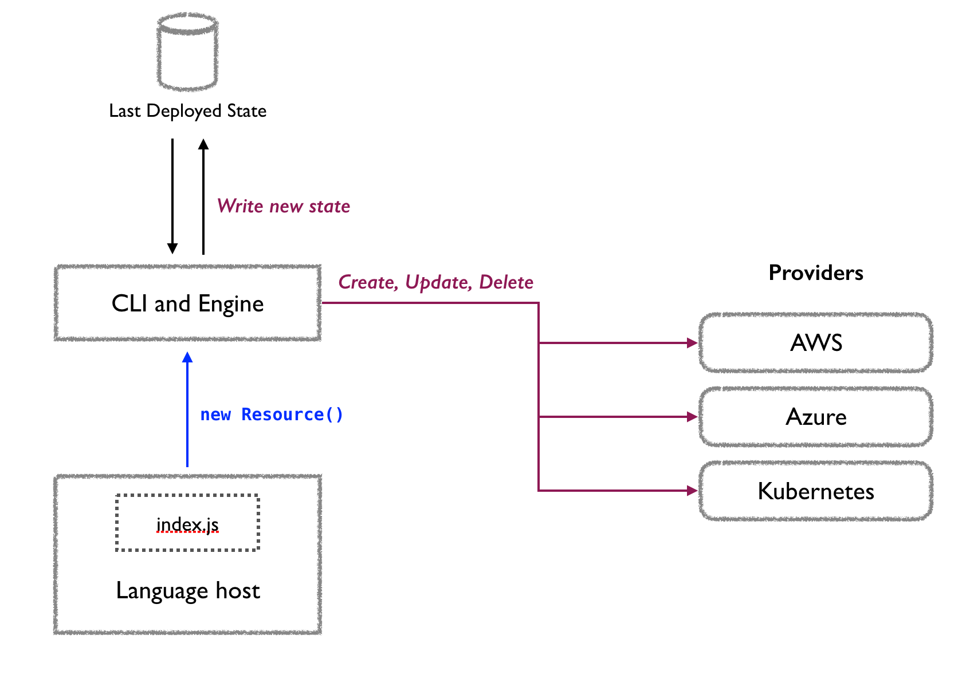

Slide 10
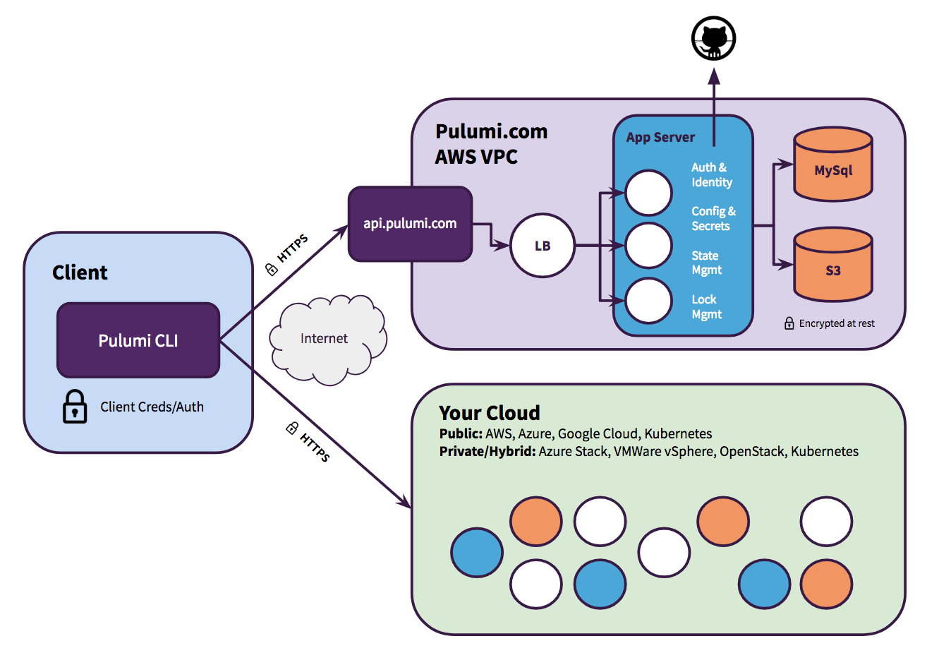
Backend and State
Tracks state of stack
Inputs/Outputs
Secrets
Config Values
Hosted SaaS or Self Hosted
Importable/Exportable

Slide 11
Input/Output Objects
Data for resources that will be created
Inputs
Become Outputs
Outputs
Result after the resource is created
Ex: GUID of a storage account
Resources using an Output are dependencies

Slide 12
Using/Setting Outputs
Apply() method
var url = vm.DnsName.Apply(dnsName => "https://" + dnsName);
String Interpolation
var url = Output.Format($"http://{hostname}:{port}/");
Hoisting
var myOutput = vm.Id;

Slide 13
Custom Outputs
Create custom Outputs for later access
Whatever You Want
Connection String to storage account (better store as a secret)
[OutputAttribute] on property
Value stored in Stack State

Slide 14
Config
YAML files
Sorry
Per Stack
Optional and Required methods
var x = config.Require("name");
var y = config.GetInt32("lucky") ?? 42;
var z = config.RequireObject<MyObject>("data");

Slide 15
Secrets
Encrypted
In Config
Get value similar to config
Config.GetSecret(key)
Config.RequireSecret(key)
In Outputs
Create value as Output<string>
Output.CreateSecret(value)
Hidden in Web Console
Can be viewed in CLI

Slide 16
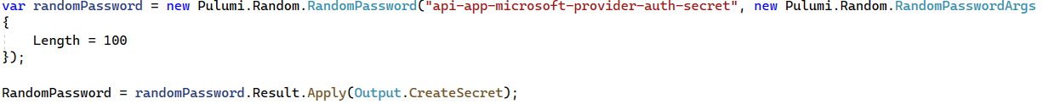
Random Values
Create random values as a resource
Password
GUID aka UUID

Slide 17
Reference Existing Infrastructure
Getter functions
By Pulumi Name or cloud native id
READ-ONLY
Pulumi will not modify the resource
Pulumi will not store state of resource in backend

Slide 18
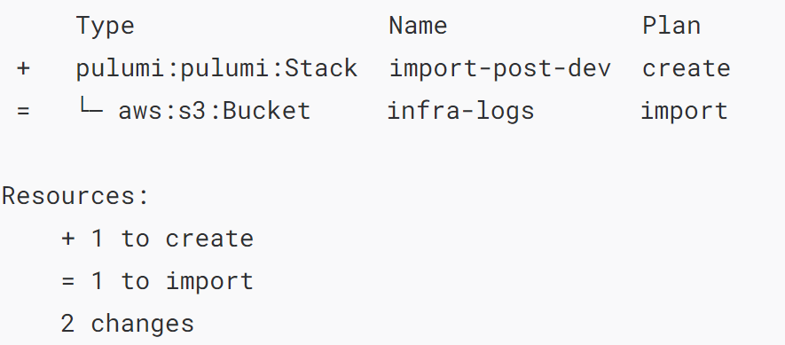
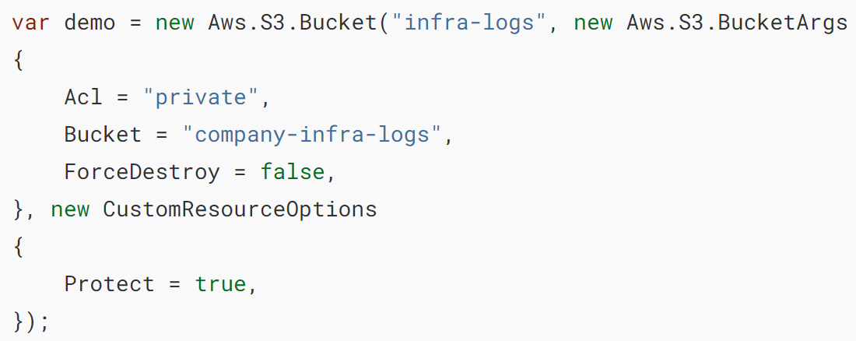
Import Existing Infrastructure
CLI Command:
pulumi import aws:s3/bucket:Bucket infra-logs company-infra-logs

Slide 19
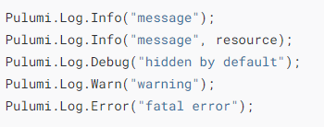
Logging
Output log info
Console.WriteLine() also works

Slide 20
Runtime Debugging
Debugger.Launch();
Attach from there

Slide 21
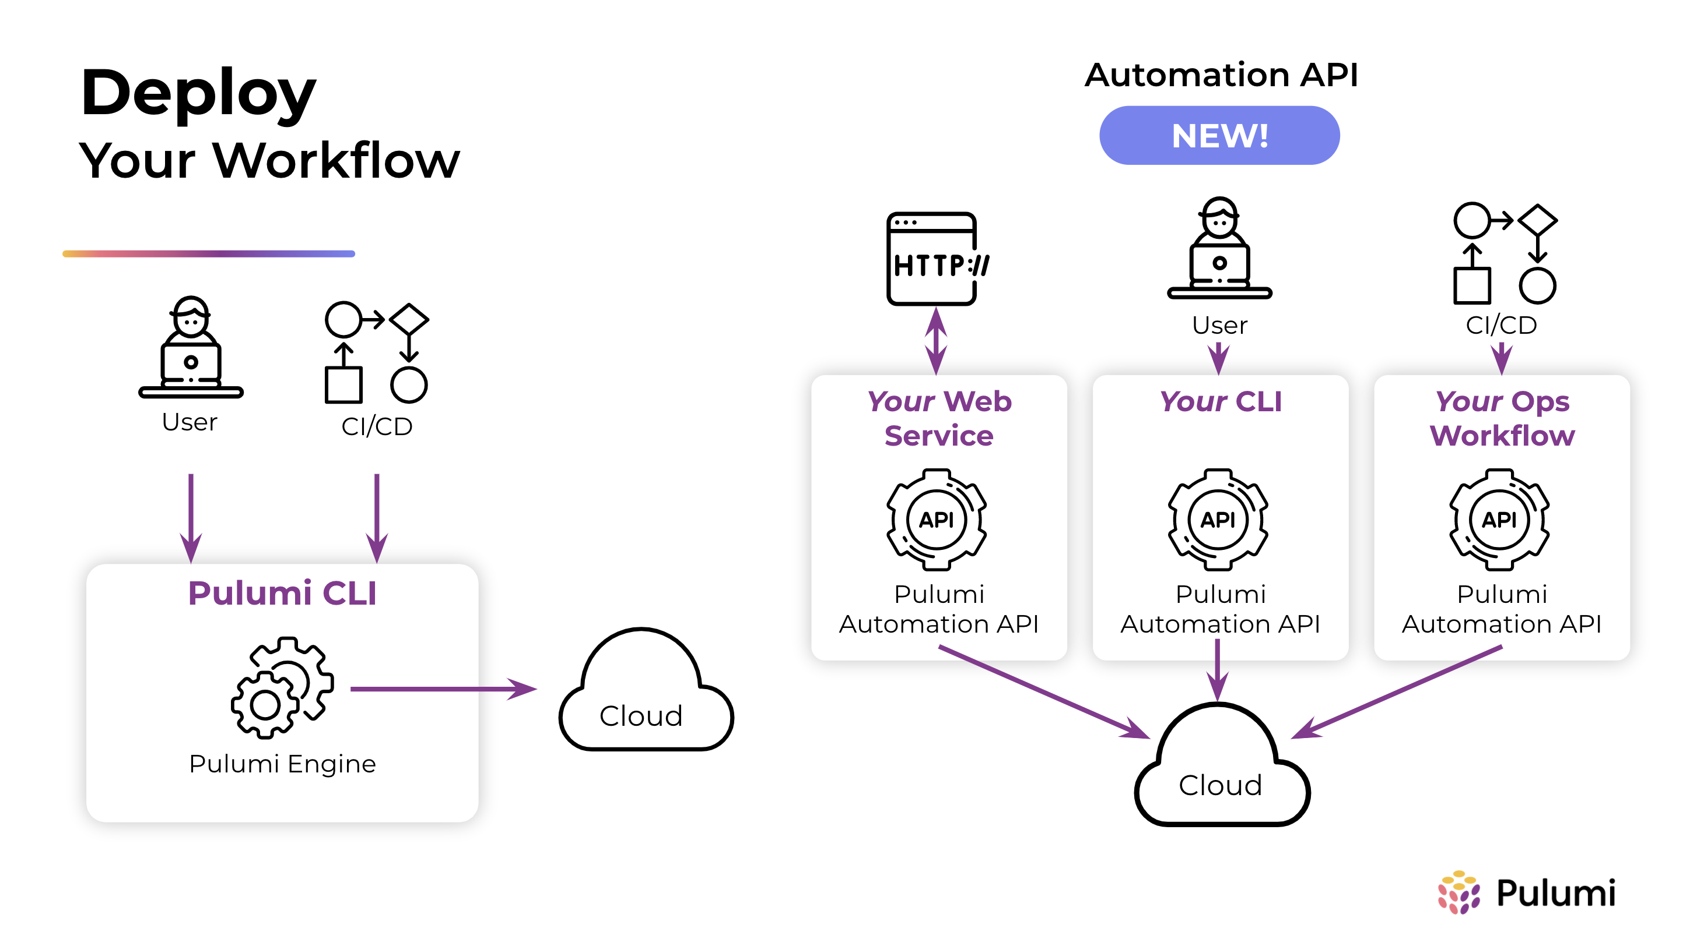
Automation API
Call Pulumi in your custom code
No need to call CLI

Slide 23
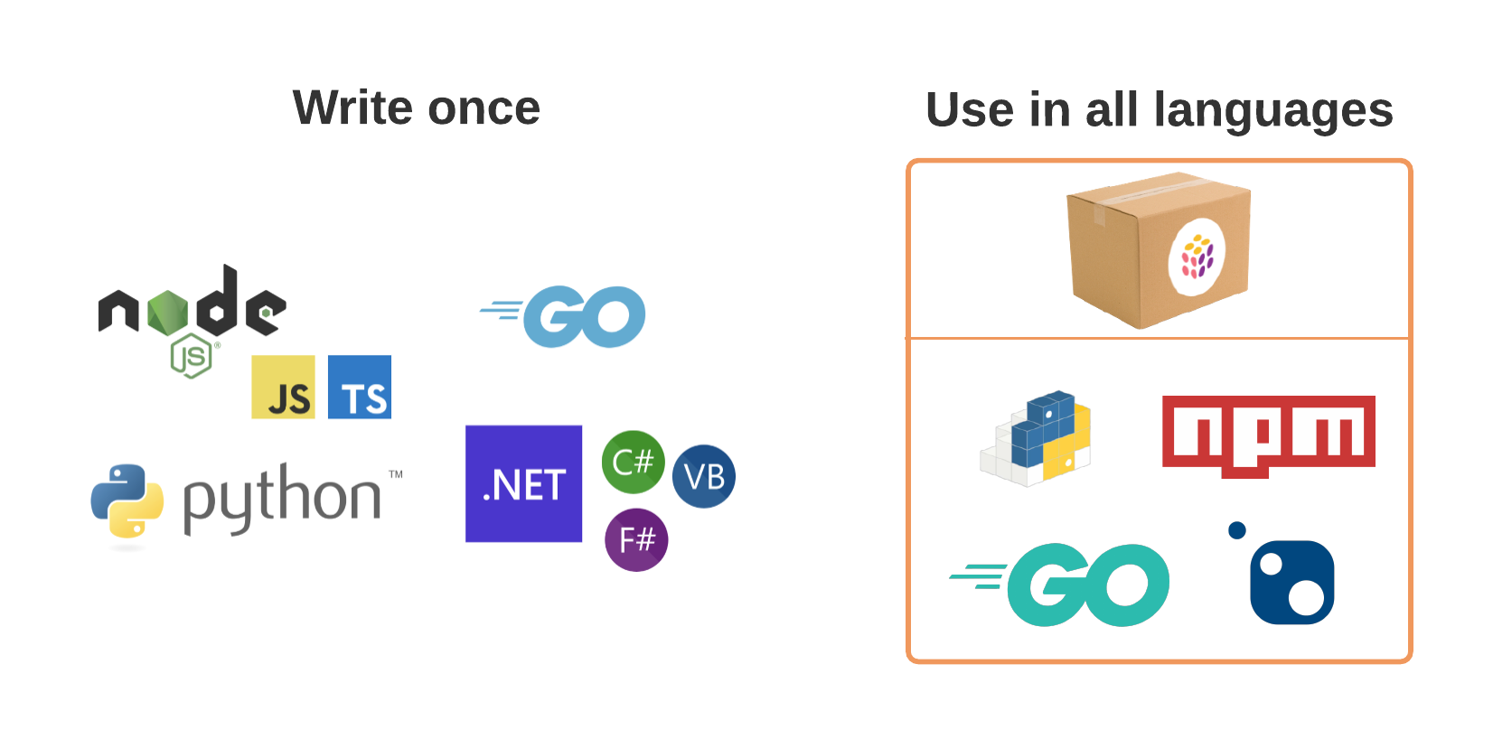
Pulumi Packages
Write your code
Generate the package manifest
Generate the packages
Publish to: NuGet, NPM, etc

Slide 24
Converters
Convert current solution to Pulumi
Azure ARM: https://www.pulumi.com/arm2pulumi/
Terraform: https://www.pulumi.com/tf2pulumi/
Kubernetes YAML: https://www.pulumi.com/kube2pulumi/
Should use as a starting guide

Slide 25
Reminder
All Presentations: github.com/ProgrammerAl/Presentations-2022
ProgrammerAL
Al Rodriguez

